Slide 1
W3C PROV Constraints
ISWC 2013
Paul Groth
slide help from Ivan Herman

Slide 2
Checking provenance statements (“Constraints”)
Provenance statements can become fairly complicated ☹
In some applications it may become advantageous to check the validity of the provenance structures.
e1
e2

Slide 3
Definition of the constraints
An abstract data model for provenance (with its own, abstract notation) is also published
http://www.w3.org/TR/prov-n/
entity(<http://.../isbn/000651409X>)
activity(:WritingTheBook)
wasGeneratedBy(<http://.../isbn/000651409X>,:WritingTheBook)
agent(:AmitavGhosh,
[prov:type='prov:Person',foaf:name='AmitavGhosh'])
wasAttributedTo(<http://.../isbn/000651409X>,:AmitavGhosh,
[roles:witRole='roles:author'])
Note that the “qualified” versions are unnecessary at that level, relationships are n-ary

Slide 4
Definition of the constraints
A separate document defines the constraints on the abstract data model
http://www.w3.org/TR/prov-constraints/
Constraints themselves are defined as a set of abstract rules
they may translated into:
(partially) into OWL
rules, e.g., using SPARQL
general constraint checkers on the abstract model are also doable

Slide 5
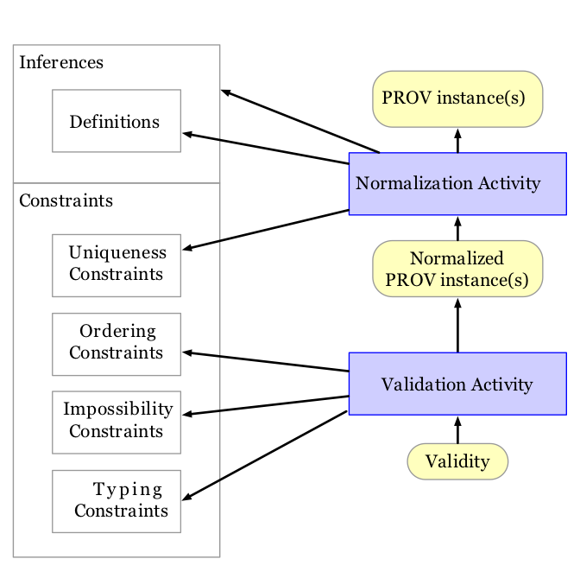

Slide 6
Normalization
From an RDF perspective
Expand
Everything is already merged by virtue of URIs
Blank nodes….

Slide 7
Events on a Lifetime
start
end
generation
invalidation
:e1
:a1

Slide 8
Uniqueness Constraints
select ?e where {
?e prov:qualifiedGeneration ?gen1 .
?gen1 prov:activity ?act .
?e prov:qualifiedGeneration ?gen2 .
?gen2 prov:activity ?act .
FILTER (?gen1 != ?gen2)
}

Slide 12
Create the event timeline
:e1
INSERT {
?gen c:precedes ?end .
}
WHERE {
?act a prov:Activity .
?act prov:qualifiedEnd ?end .
?act prov:qualifiedGeneration ?gen .
}

Slide 13
Check for cycles
select ?x where {
?x (c:precedes+|c:strictlyPrecedes+)/
c:strictlyPrecedes ?x .
}

Slide 15
Impossibility Constraint e.g. Activity & Entity disjoint
select ?e where {
?e a prov:Entity, prov:Activity .
}

Slide 17
Do you fill all the slots?
select ?asc where {
?asc a prov:Association .
FILTER NOT EXISTS {
?a prov:qualifiedAssociation ?asc .
}
}

Slide 18
Validators
Prov-check
https://github.com/pgroth/prov-check
Southampton Provenance Suite
https://provenance.ecs.soton.ac.uk

